Slide 1



TAKE YOUR REVENGE ON THIS FUCKING EDR
2024
PROCESSUS THIEF

Slide 2


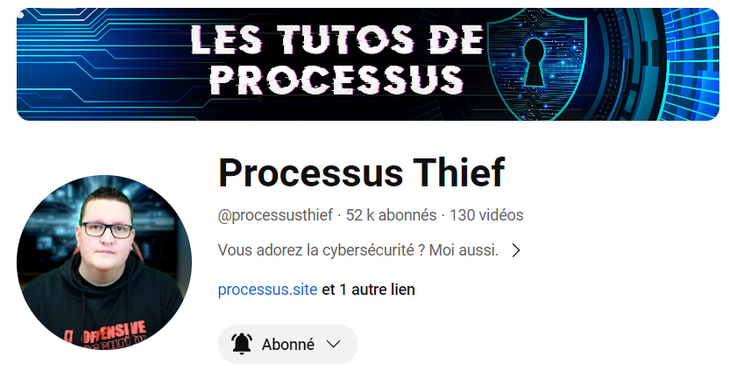
WHO IS THAT GUY ?
Processus
CAT LOVE EXPERT
And sometimes I do some cyber stuff

Slide 3

Welcome to...
my cats
notebook
All my tips and tricks about cats !
And few things about cybersecurity

Slide 4
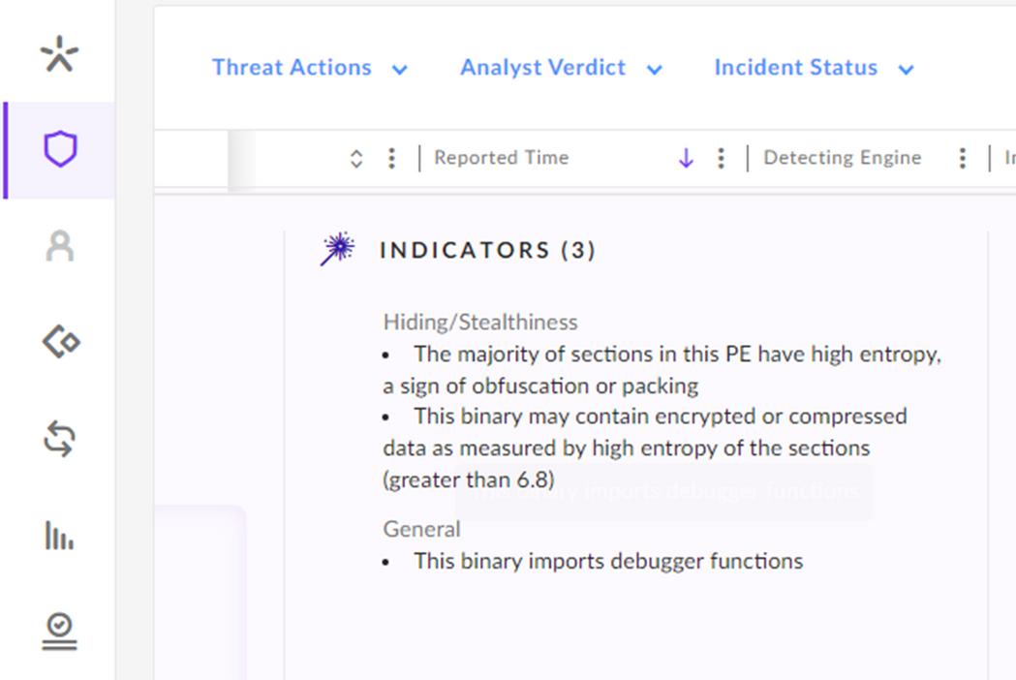


RULE 1 :
XOR is not the only key !
KEEP
CALM
and
REDUCE
YOUR
ENTROPY
Quelle technique d’obfuscation induit une forte augmentation de l’entropie ?
IP based obfuscation
Mac based obfuscation
UUID based obfuscation
AES

Slide 5
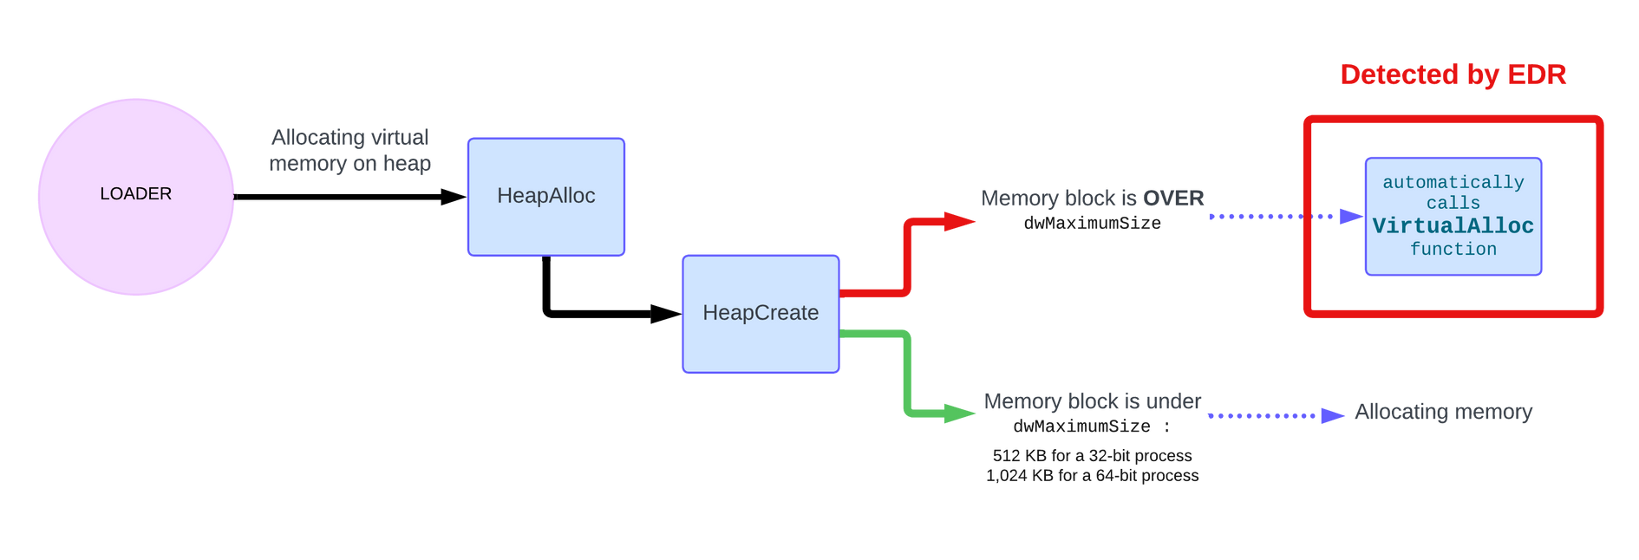
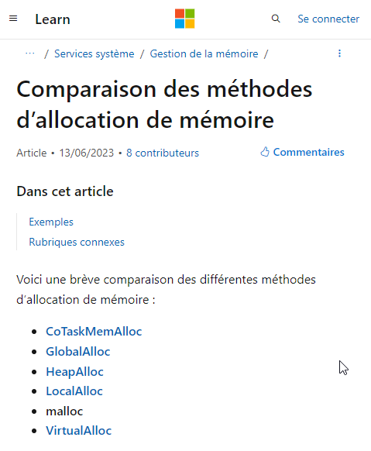


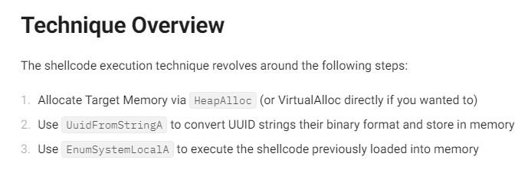
RULE 2 :
VirtualAlloc is not the only option !

Slide 6
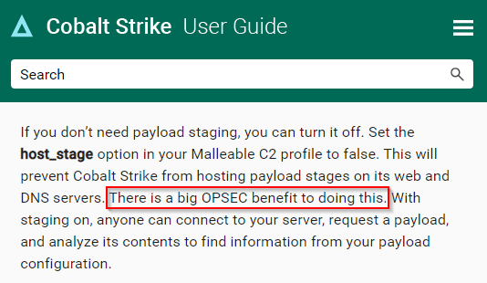
RULE 3 :
Prefer stageless payload
  Avoid detection from curious cats (checksum bruteforce)
  Prevent generic execution process (reflective loading)

Slide 7

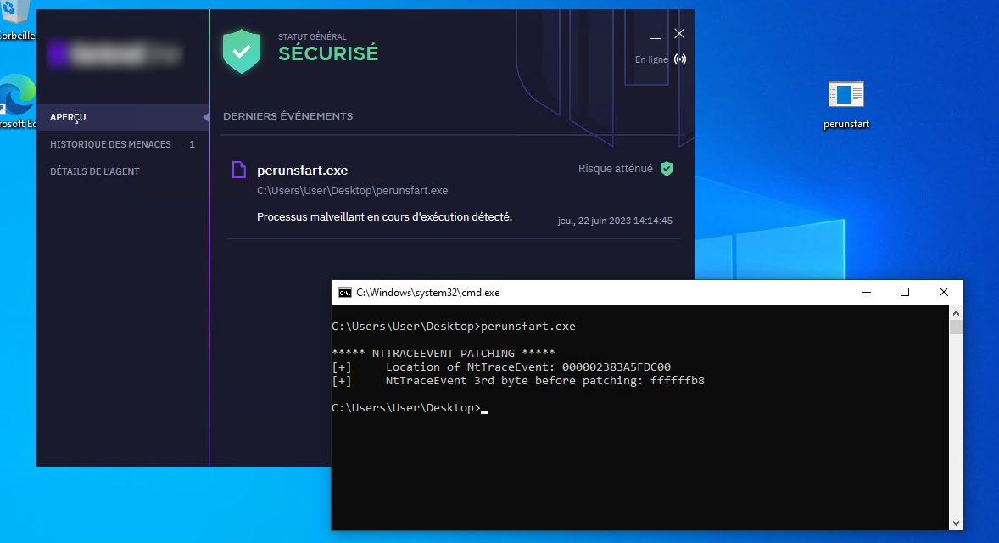
RULE 4 :
Stay away from memory protection changes
REMEMBER LAST YEAR ?

Slide 8
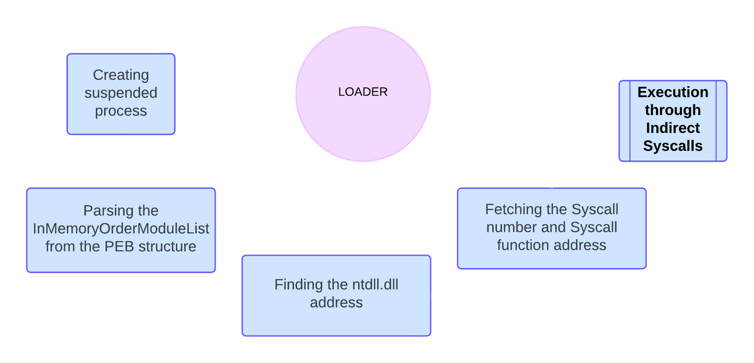
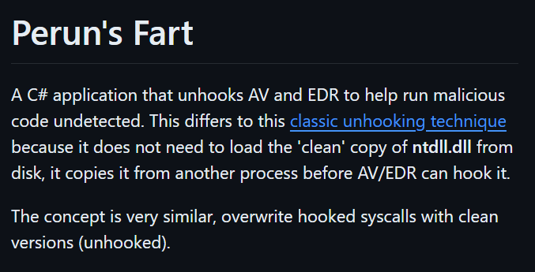

RULE 4 :
Stay away from memory protection changes
Prefer Direct or Indirect Syscalls instead !
What is it ?
Start an unhooked suspended process and steal its ntdll memory

Slide 9
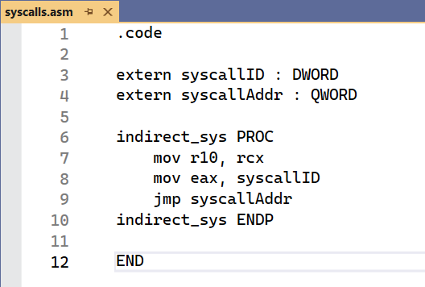

RULE 4 :
Stay away from memory protection changes
JUMP !

Slide 10
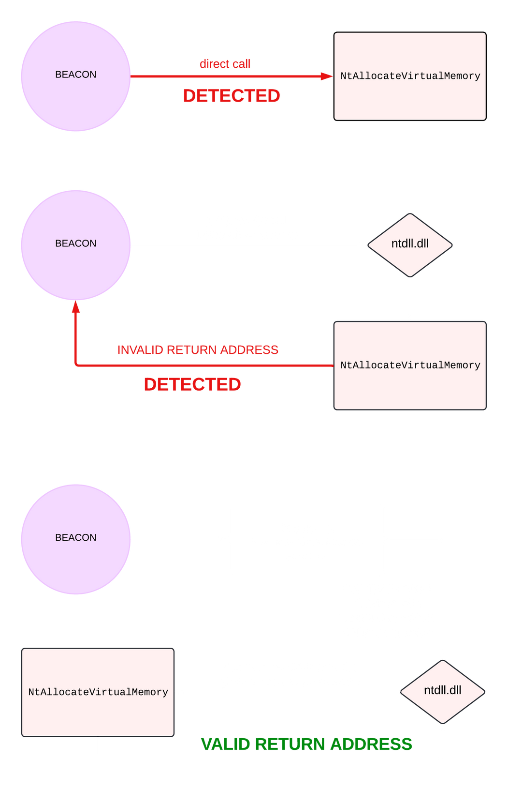
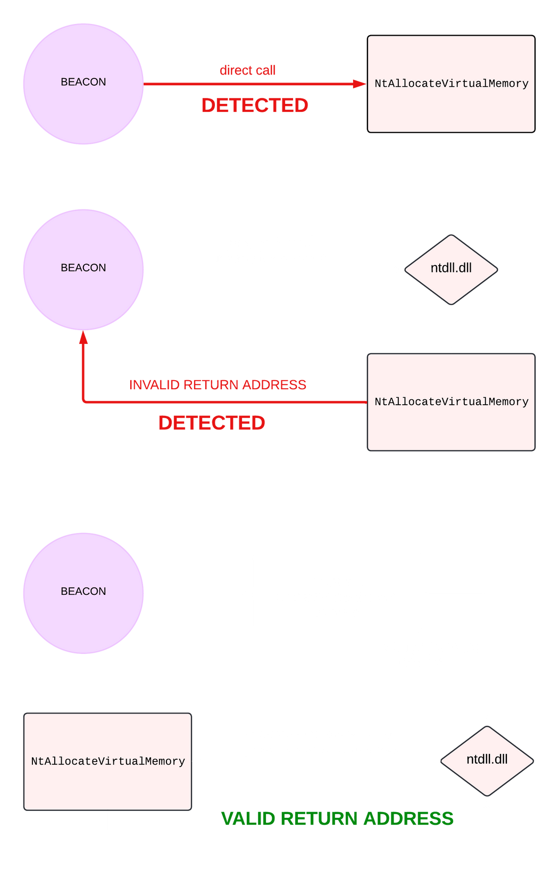
RULE 4 :
Stay away from memory protection changes
“A return address to ntdll.dll region, but stack originating from RX region is a 100% anomaly with zero chances of being a false positive.”
Chetan Nayak
A callback function executes another functions within the caller function.
But the callback function is executed in the same thread as the caller thread.
So the caller can read the callback function result from its memory !

Slide 11
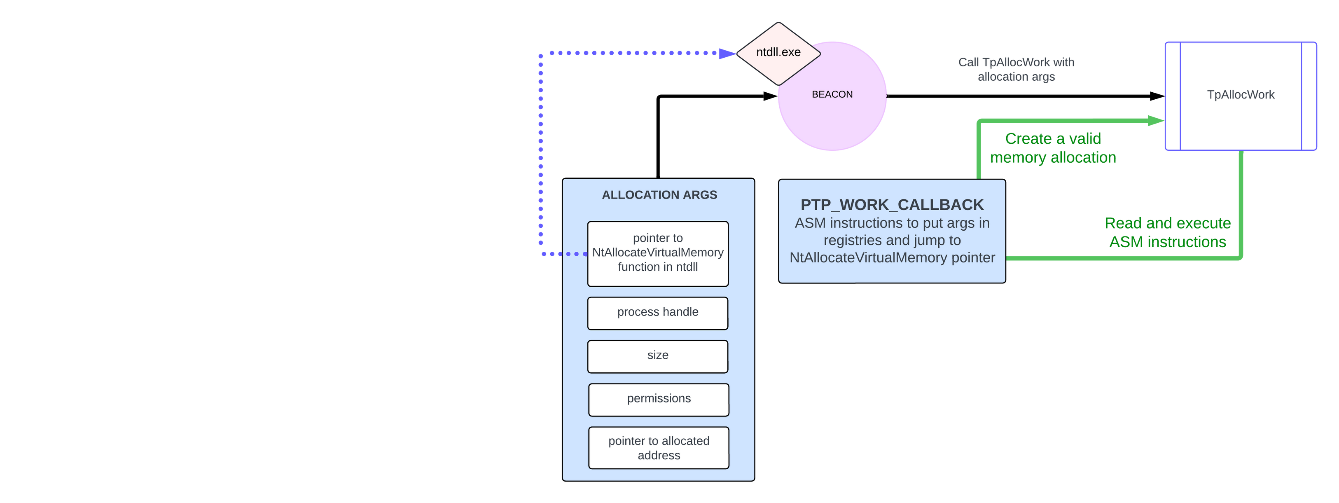
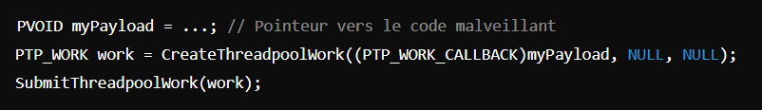
RULE 4 :
Stay away from memory protection changes
ntdll.dll

Slide 12
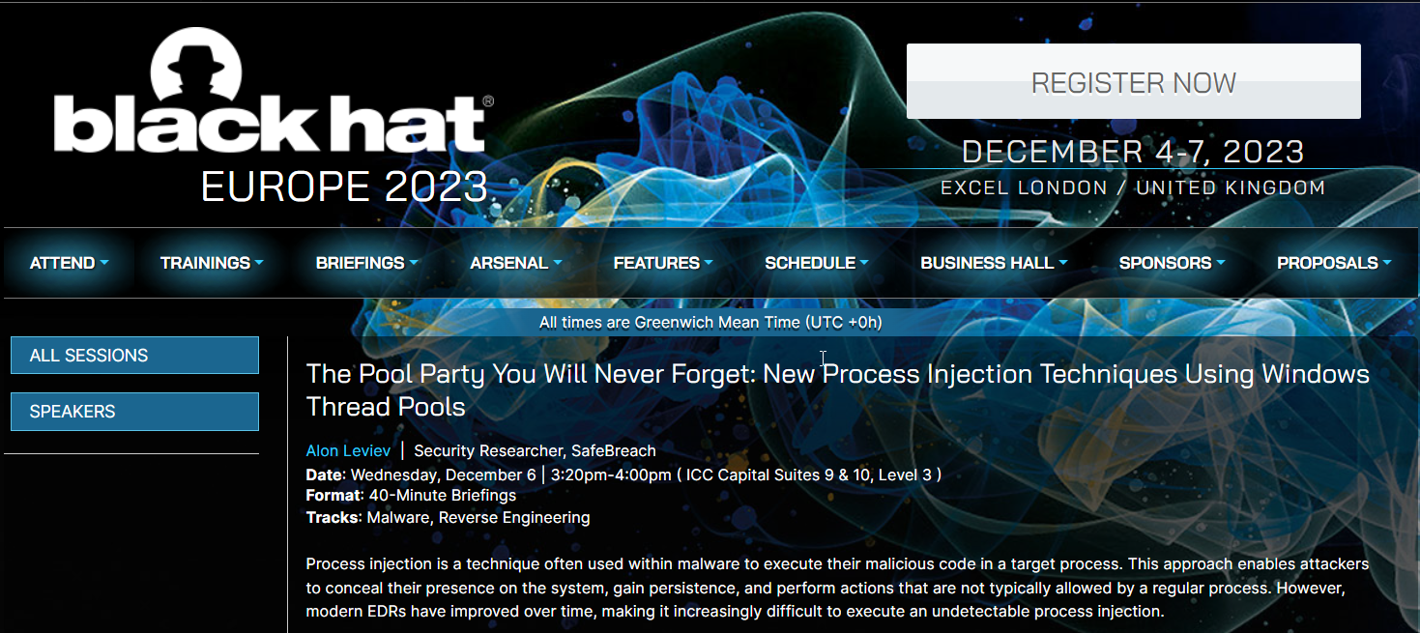
RULE 4 :
Stay away from memory protection changes
Want to learn more ?
PoolParty
“A collection of fully-undetectable process injection techniques abusing Windows Thread Pools. Presented at Black Hat EU 2023”

Slide 13

RULE 5 :
Asynchronous execution is sometimes better
Queueing APC requires a handle with full RWX privileges on the target process
It can be suspicious to allocate RWX memory
APC functions execute independently/asynchronously in the context of an existing thread
Thread must be in an alertable state (waiting for a CallBack to happen like Sleep or WaitForSingleObject) to run user-mode APC
In a suspended state, the main thread of a process is in alertable state ;)
Arrested for RWX memory allocation

Slide 14
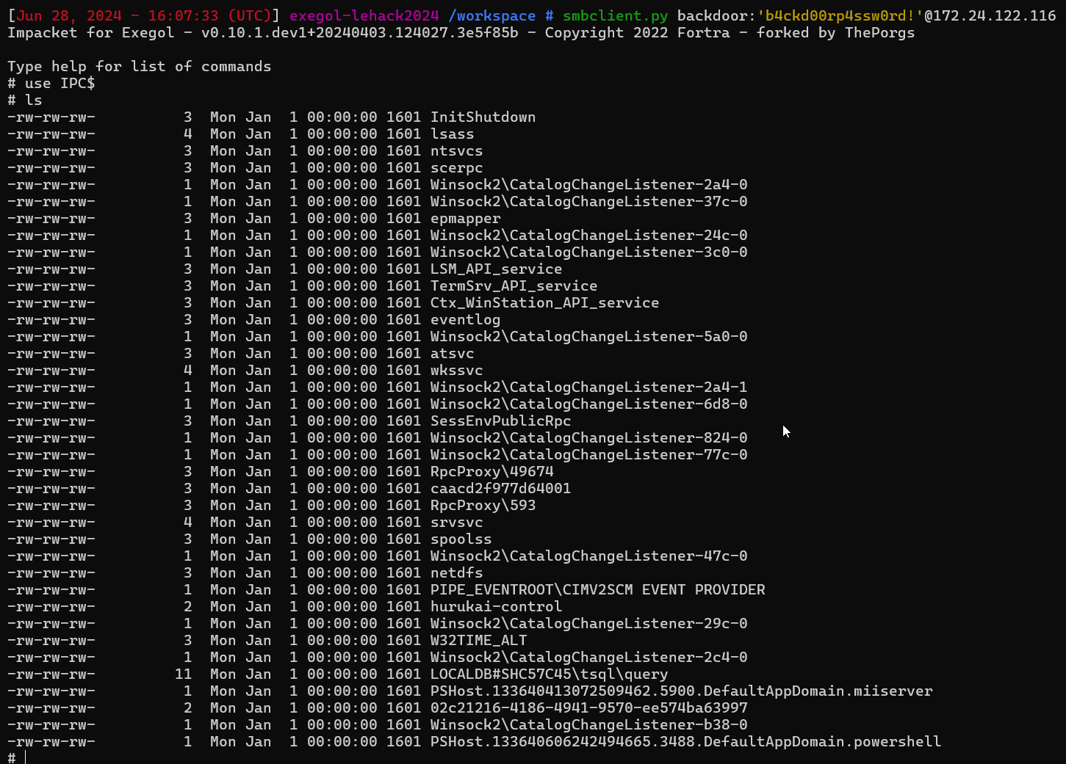
RULE 6 :
Named pipes
Pipes are one of the methods of inter-process communication (IPC)
Every pipe is placed in the root directory of the named pipe filesystem (NPFS), mounted under the special path \\.\pipe\
Pipes permit communication over network or between User-land and Kernel-land

Slide 15
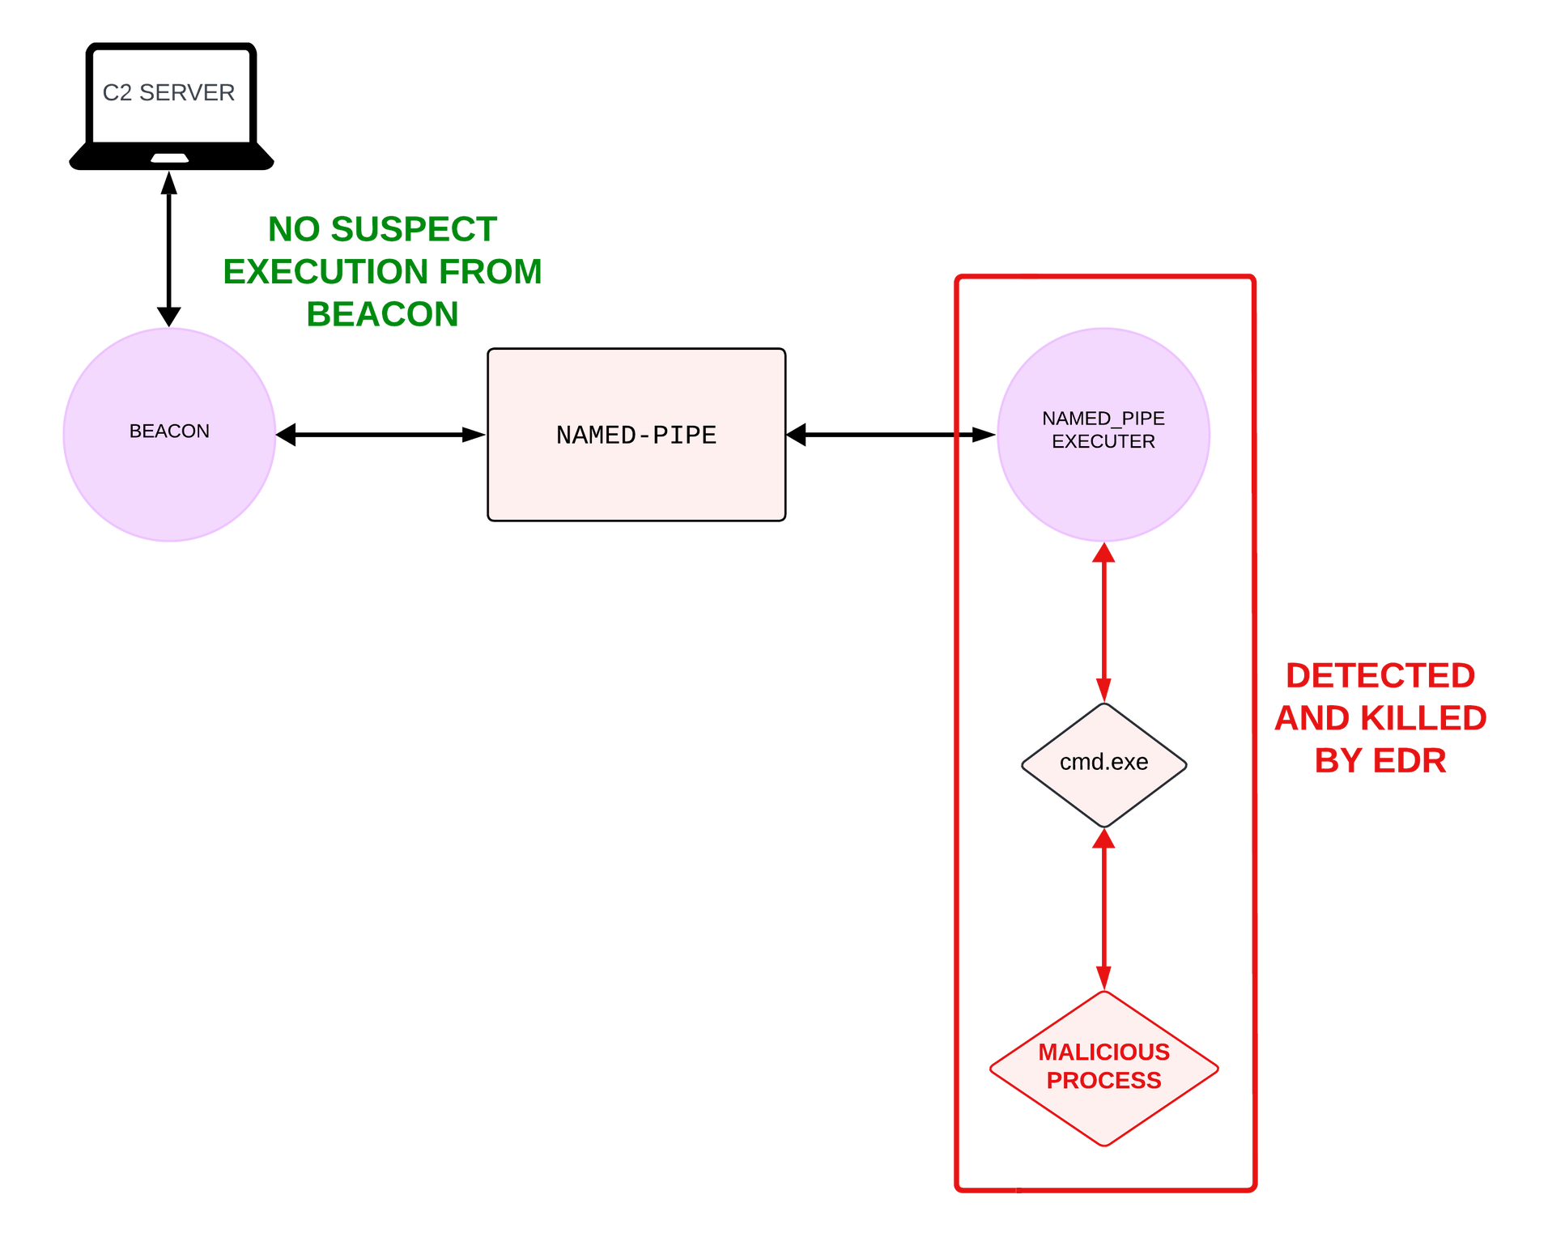

RULE 6 : named pipes
Stealthier than TCP connections
Admin access not required
Supports duplex communication
YOU CAN’T SEE ME NOW

Slide 16
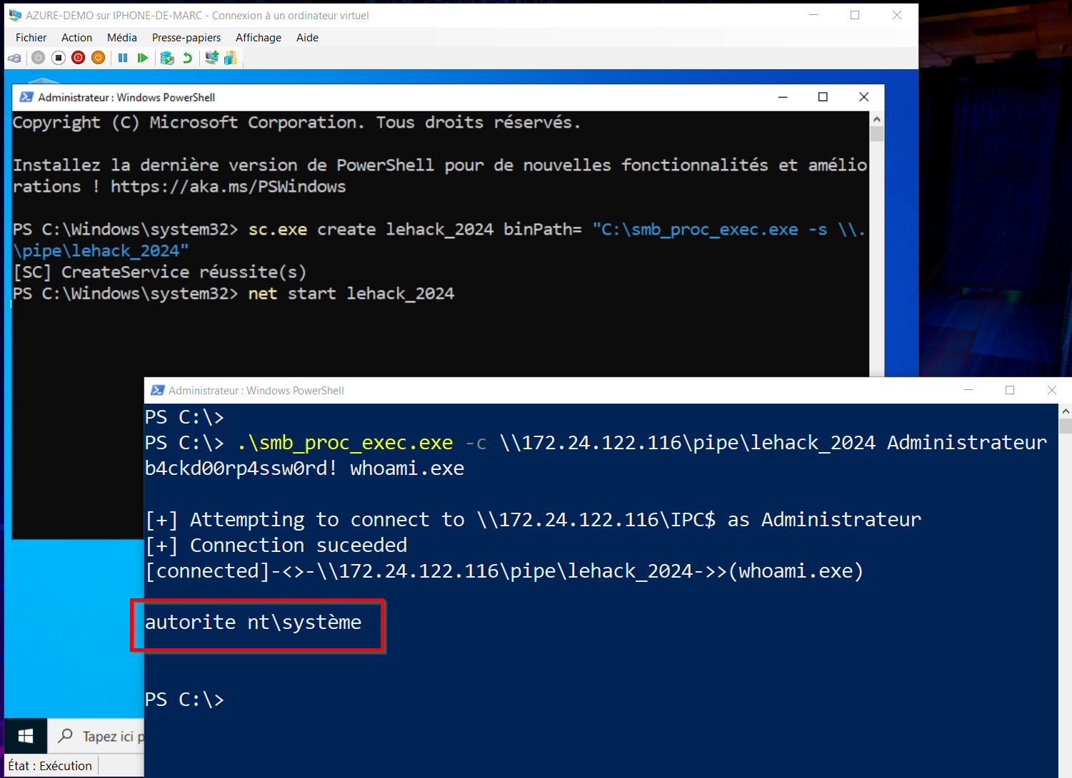
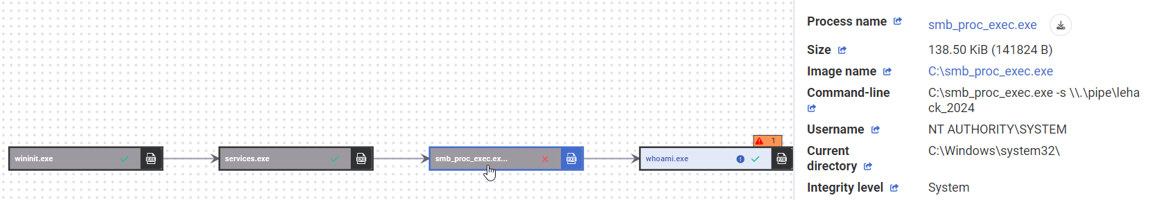
RULE 6 : named pipes
The technique can also be used for lateralisation !

Slide 17
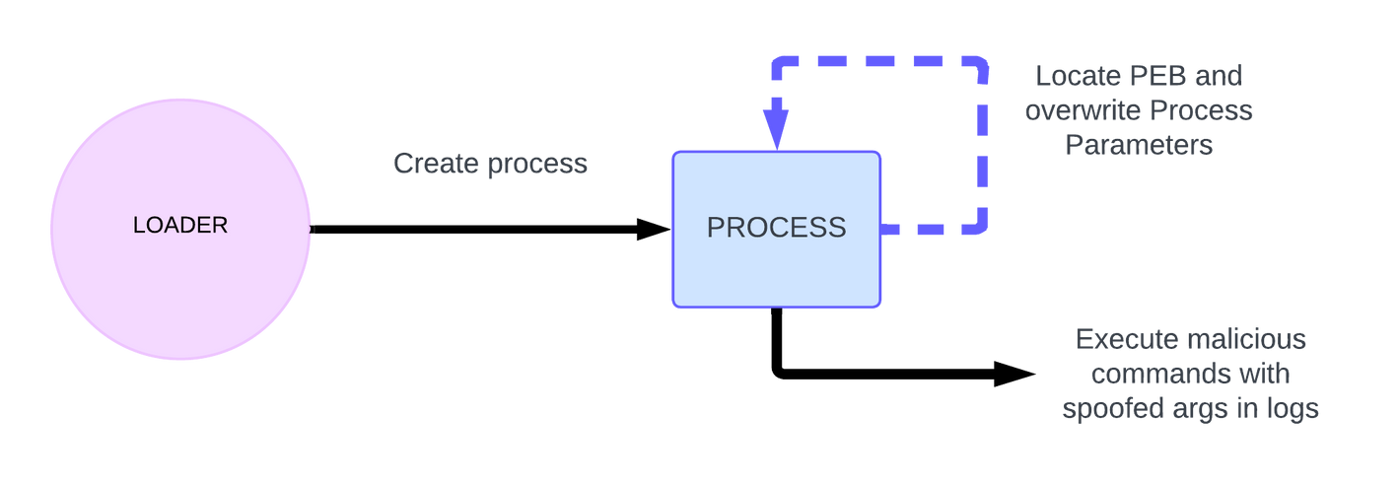
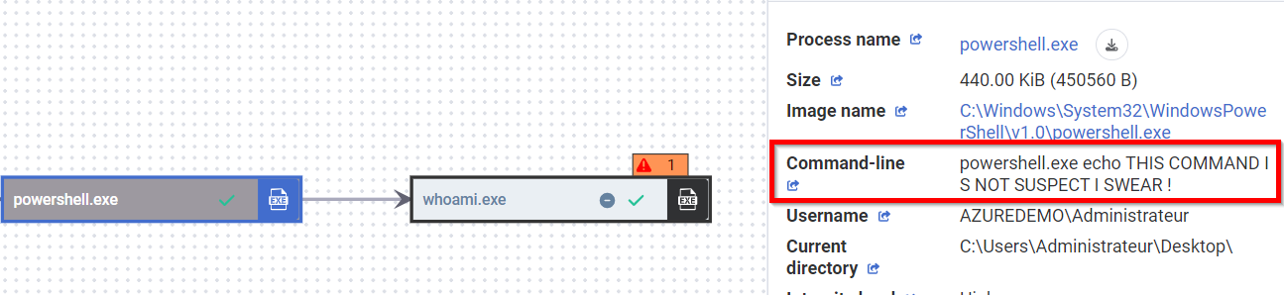
RULE 7 :
Command-line Argument Spoofing
Shows spoofed arguments in Sysmon/Process Hacker/EDR logs

Slide 18
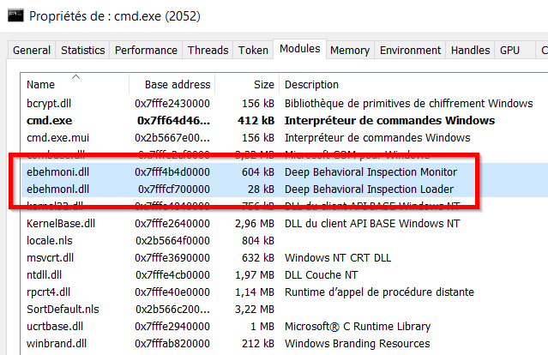
RULE 8 :
Microsoft Process Mitigation Policy
Process Mitigation policy prevents non-Microsoft signed DLLs from loading into a process
Normal process with an injected DLL

Slide 19
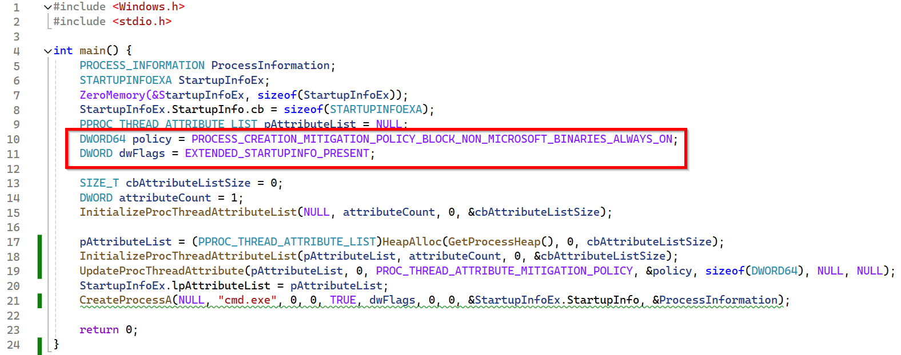
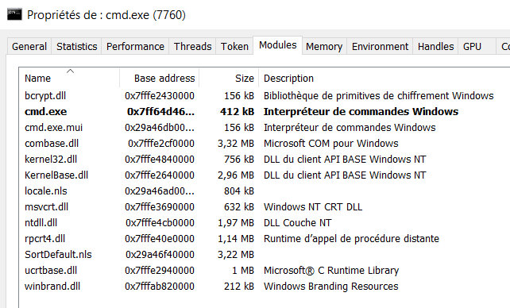
RULE 8 :
Microsoft Process Mitigation Policy
Most EDR’s dll are signed today, but sometimes AV or EDR don’t...
With a restricted policy, detection DLL is not injected

Slide 20
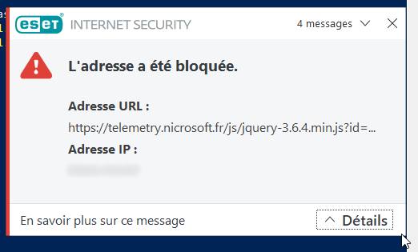

RULE 8 :
Microsoft Process Mitigation Policy
Don’t forget the anti-botnet protection !!

Slide 21
RULE 9 :
Don’t try to mix techniques !
More techniques :
  More possibility of detection
  More Machine Learning detection
FOCUS on a specific technique and act as legitimately as possible
INDIRECT SYSCALLS
EARLY BIRD INJECTION
PPID SPOOFING
PERUN’S FART

Slide 22
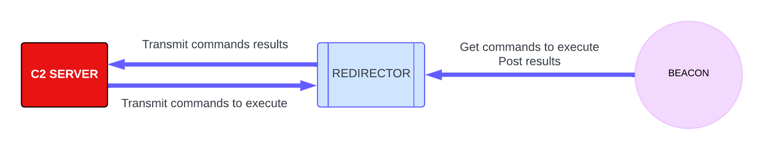
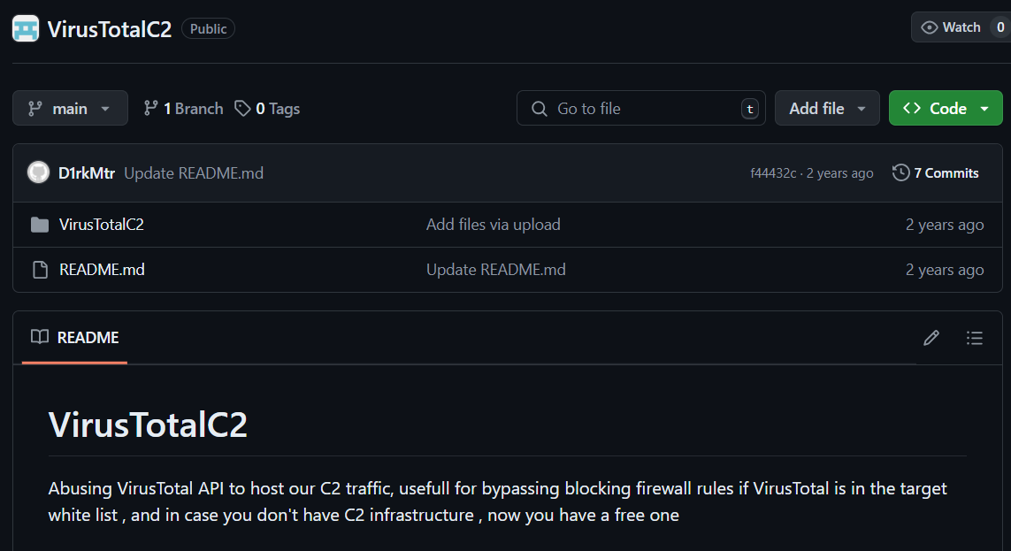
RULE 10 :
PROTECT YOUR C2
GitHub devtunnel, Google Drive, Azure FrontDoor, AWS CloudFront...

Slide 23
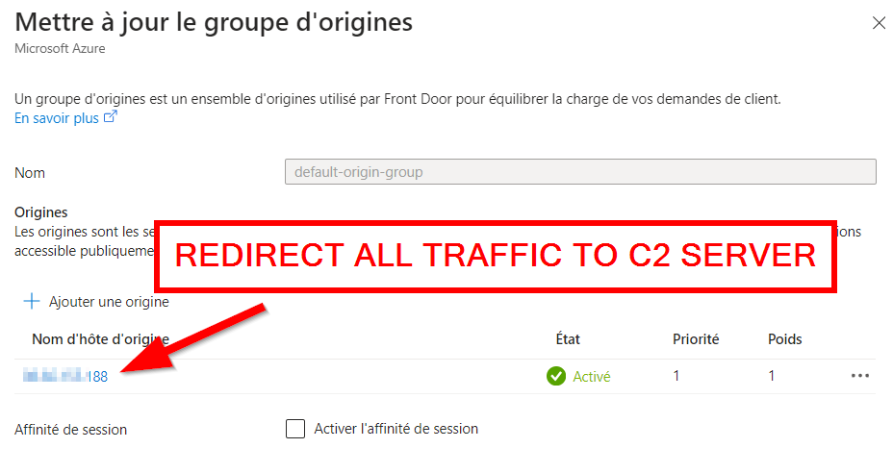
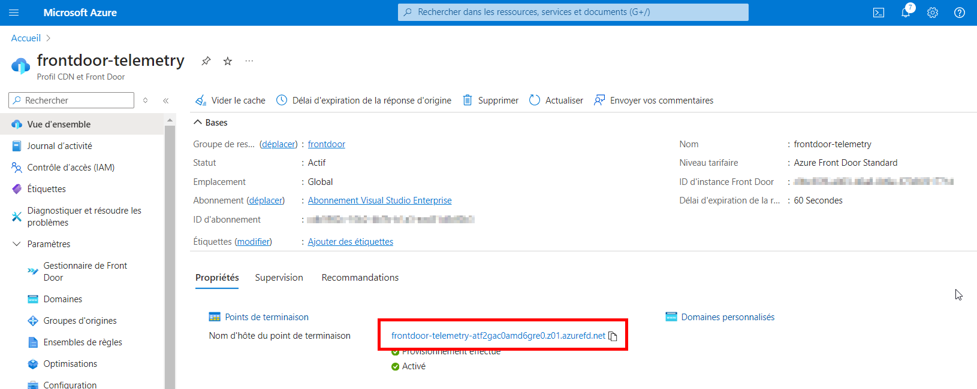
RULE 10 :
PROTECT YOUR C2

Slide 24
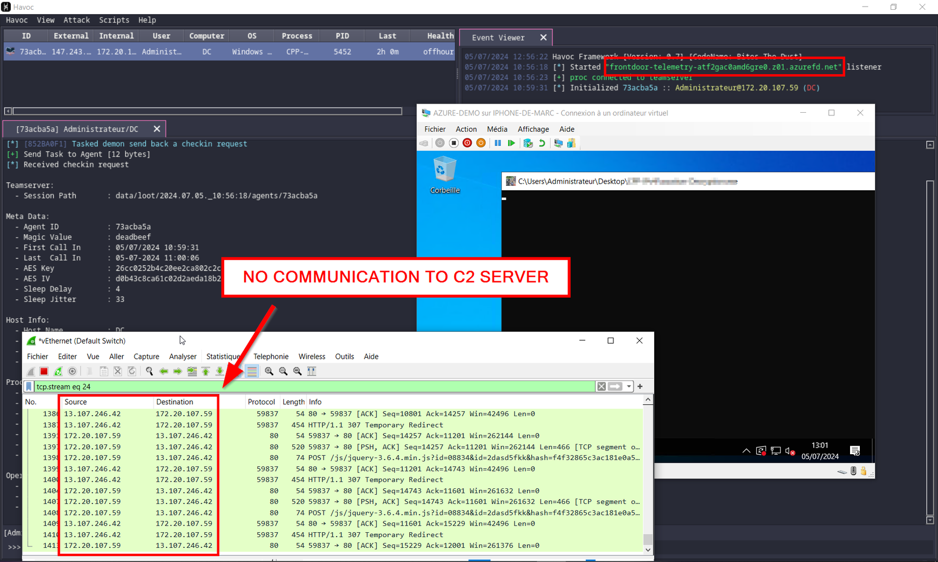
RULE 10 :
PROTECT YOUR C2

Slide 25
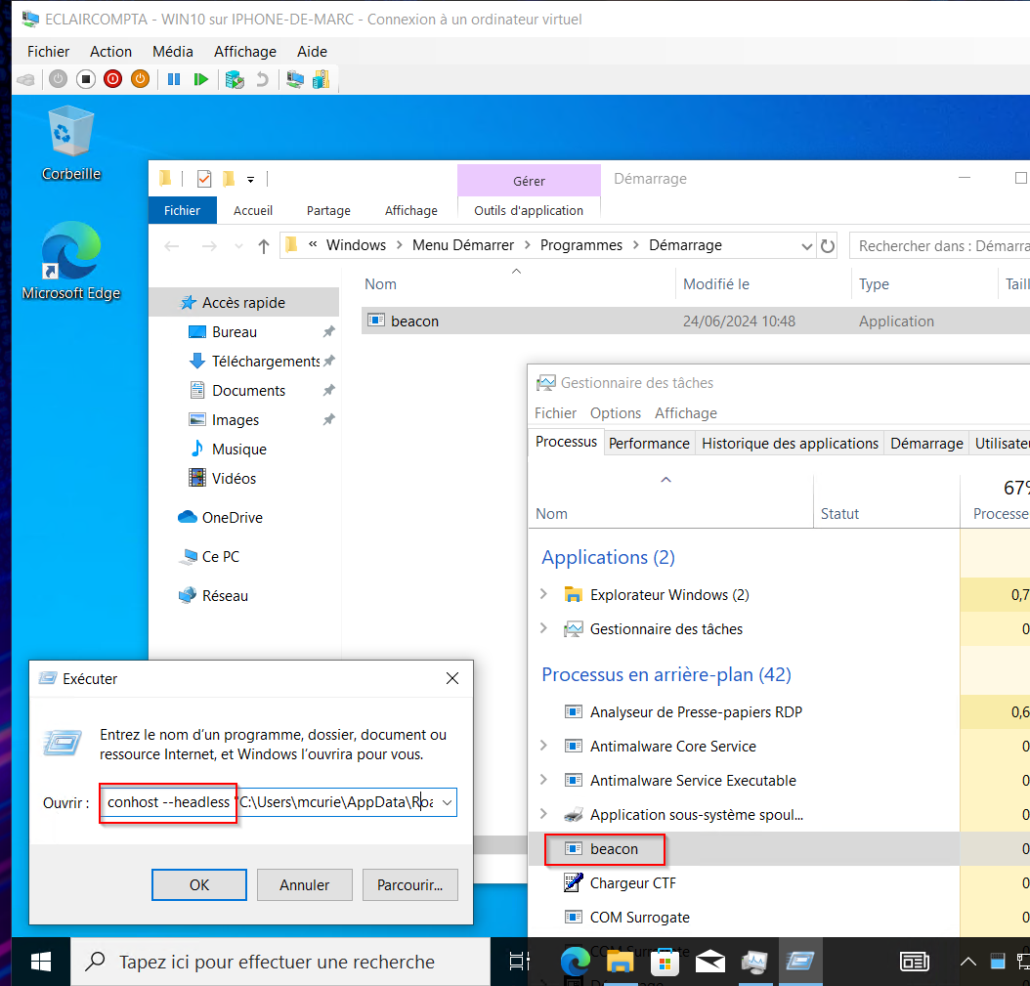
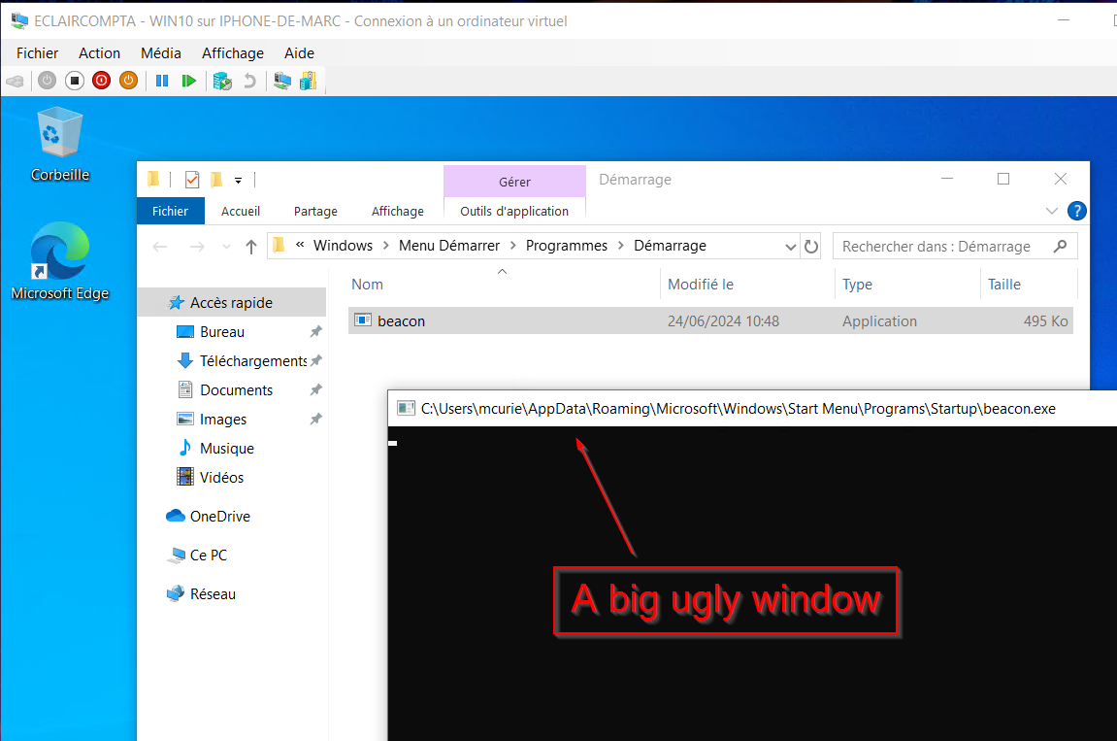
Tips :
conhost can hide your window

Slide 26
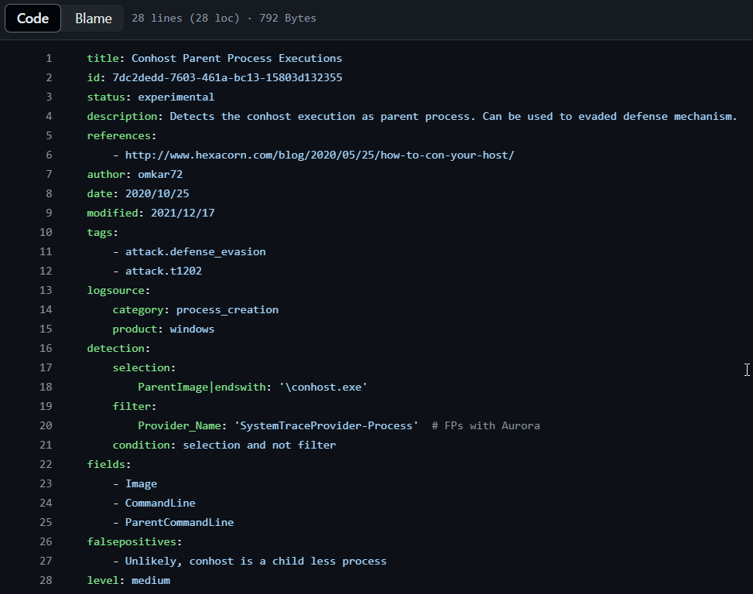
Tips bis :
But it can still be detected !

Slide 27
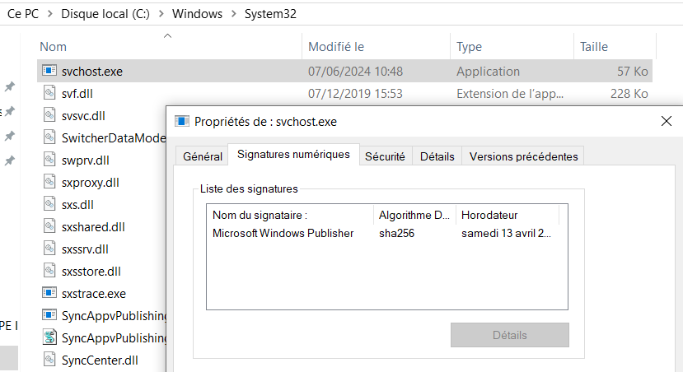
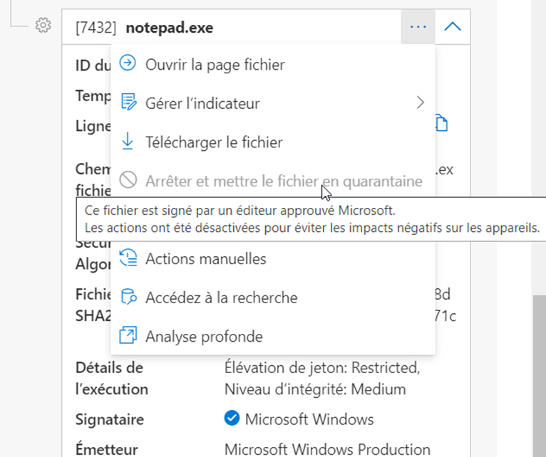

Tips :
Sometime they like (too much) signed processes

Slide 28
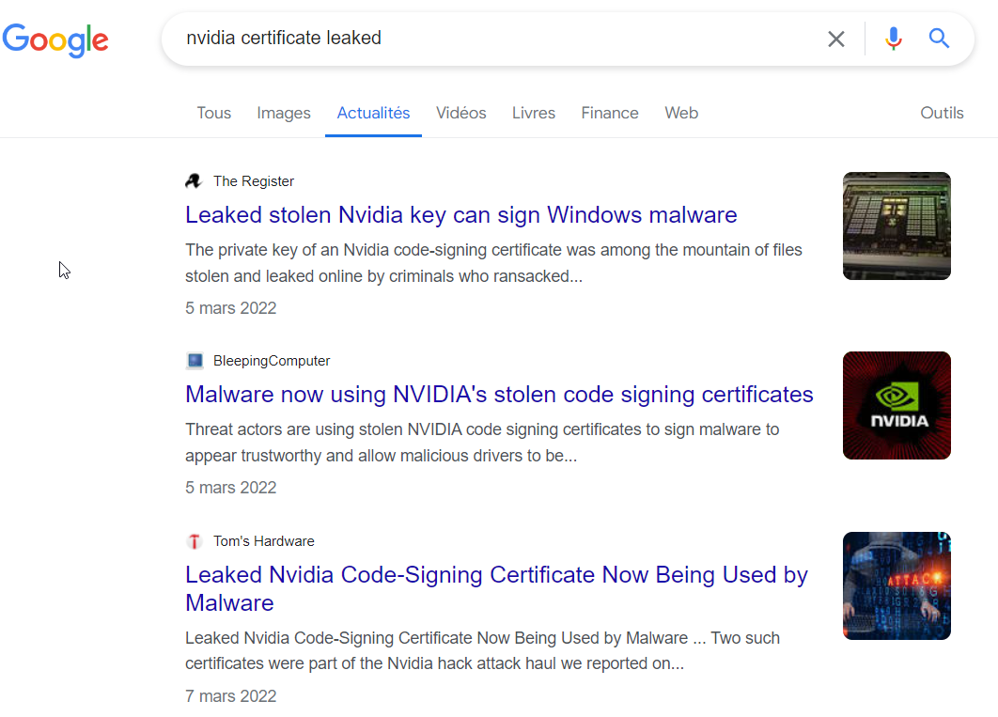
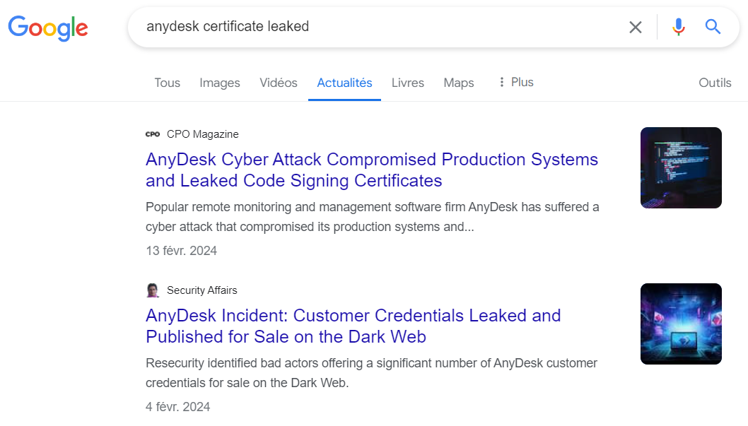
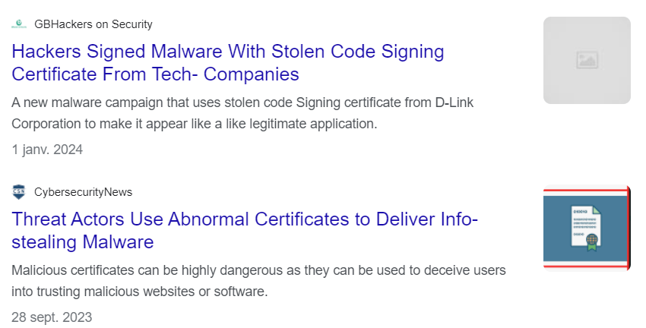
Tips : You can find leaked certs !!
do you really trust your “TRUSTED” certificates?

Slide 29

SEND YOUR PAYLOAD

Slide 30
BONUS

Slide 31

Let’s catch the birds !!
How to dump an entire domain without triggering security mechanisms...

Slide 32
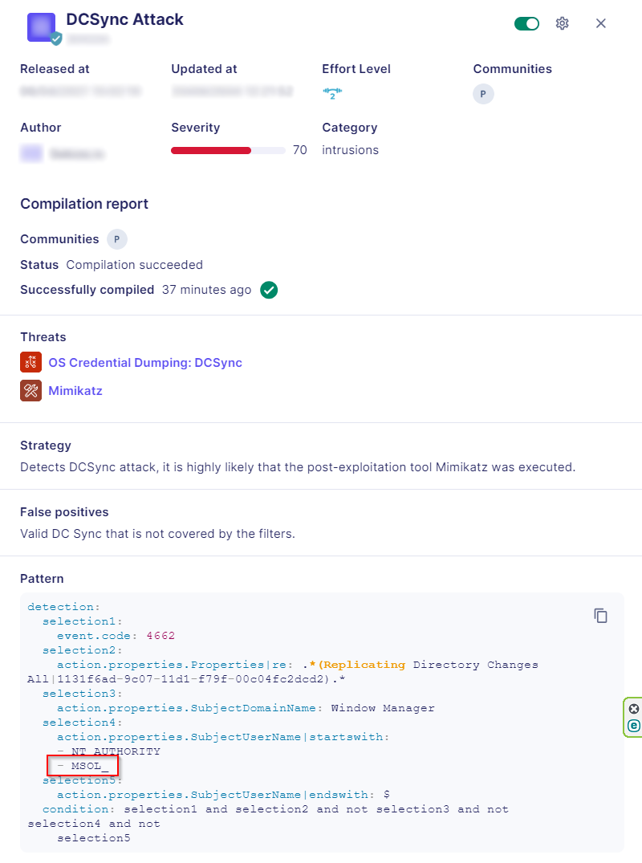
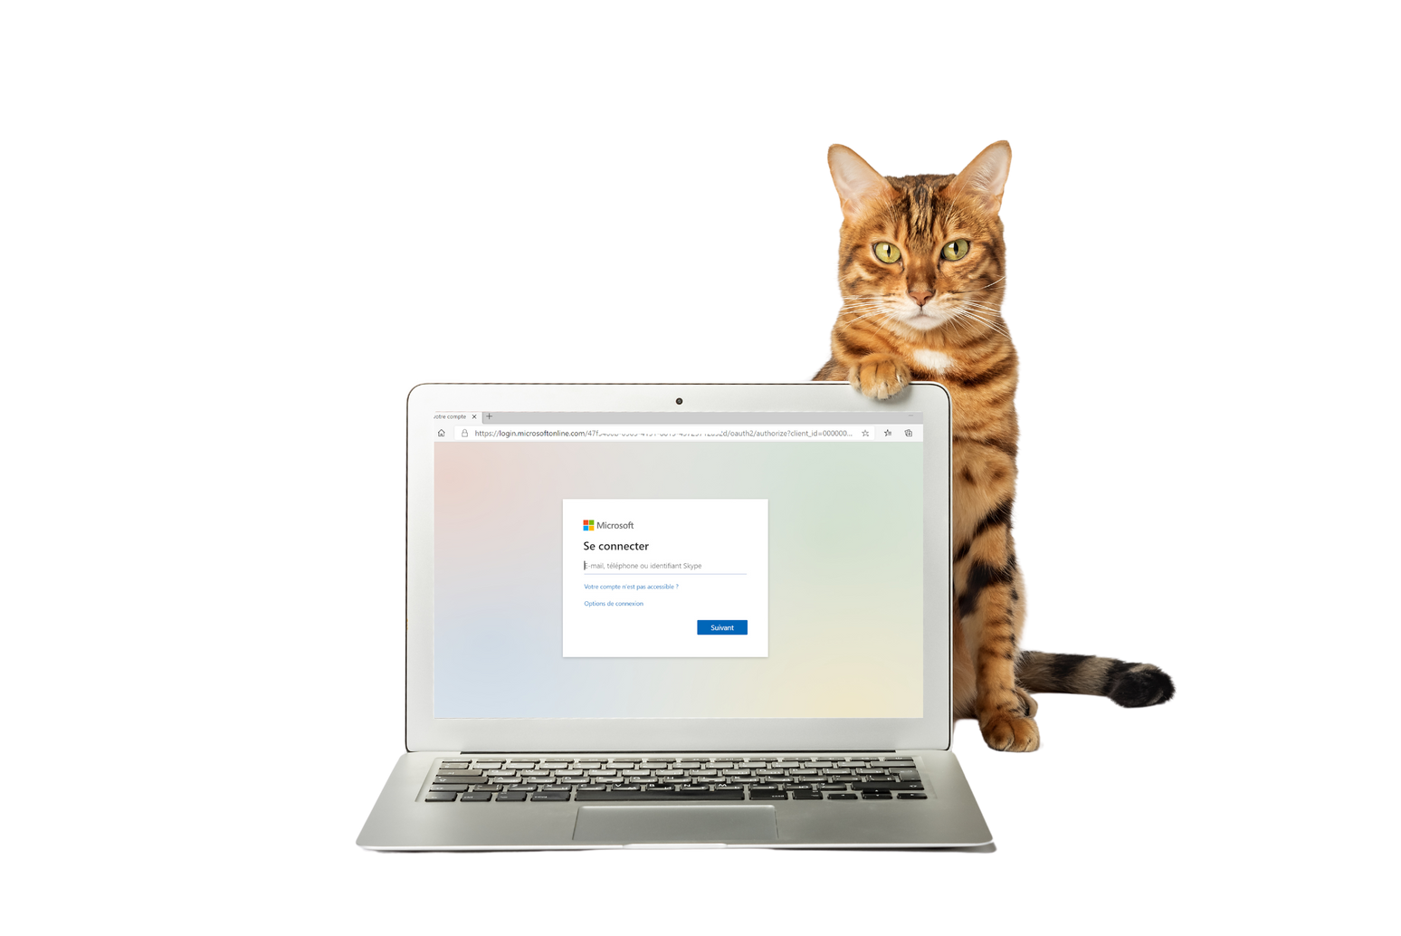
Evading from DCSync detection
MSOL Account is excluded from Sigma rules because it’s a legit user !

Slide 33
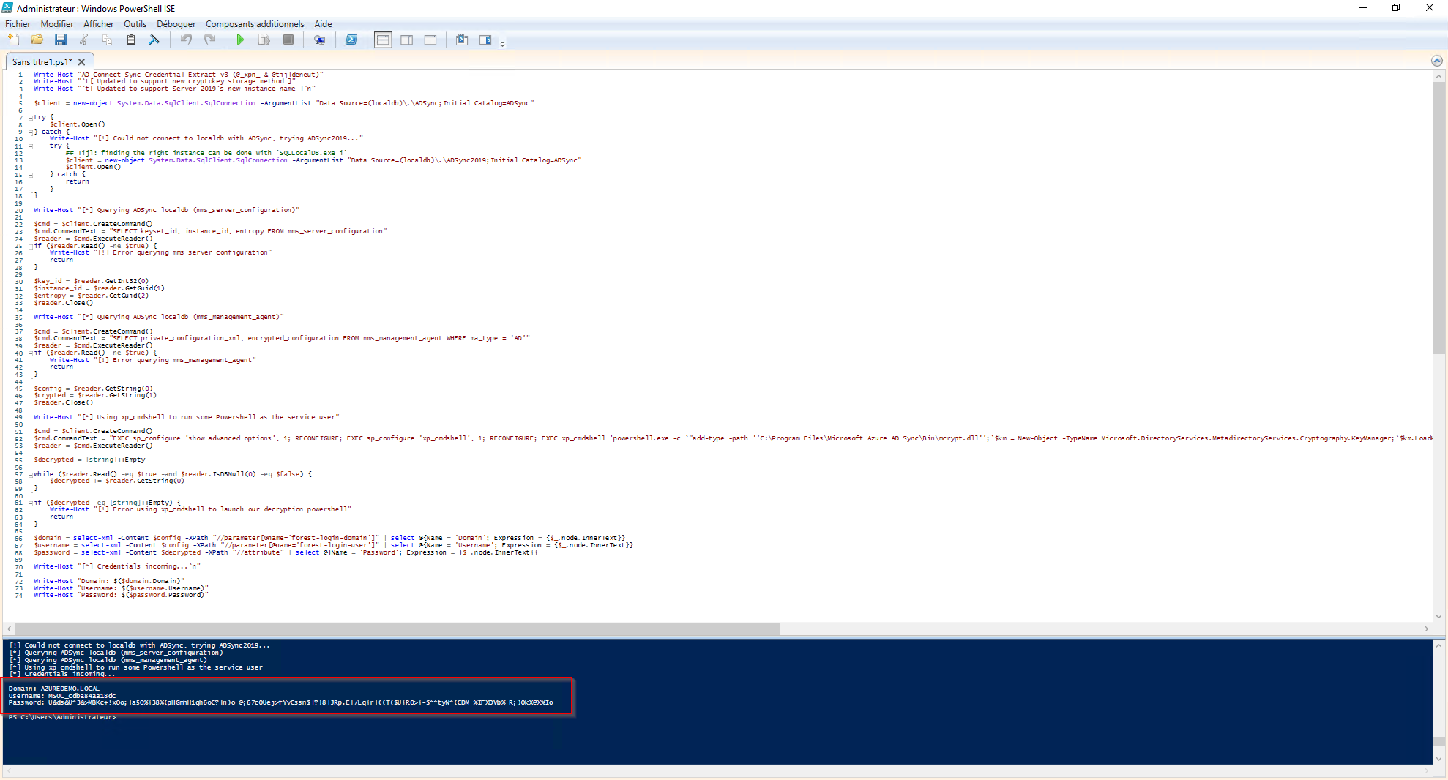

Stealing MSOL credentials
MSOL Account password is store in an encrypted format in the ADSync database
Encryption is performed through DPAPI
So, we can use the mcrypt.dll library to decrypt it...
THEY SAID IT WAS ENCRYPTED

Slide 34

But...
NOOOOOO
You need an access on the DC.

Slide 35
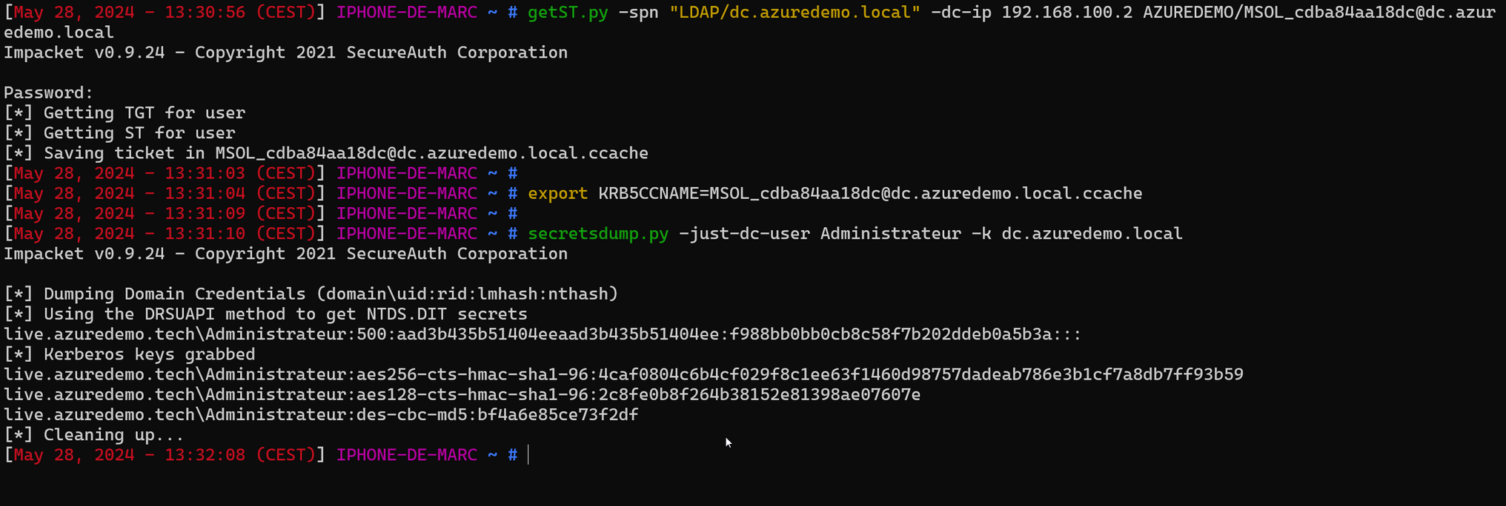


Dumping the creds !
DCSync with MSOL account without triggering alert !!

Slide 36
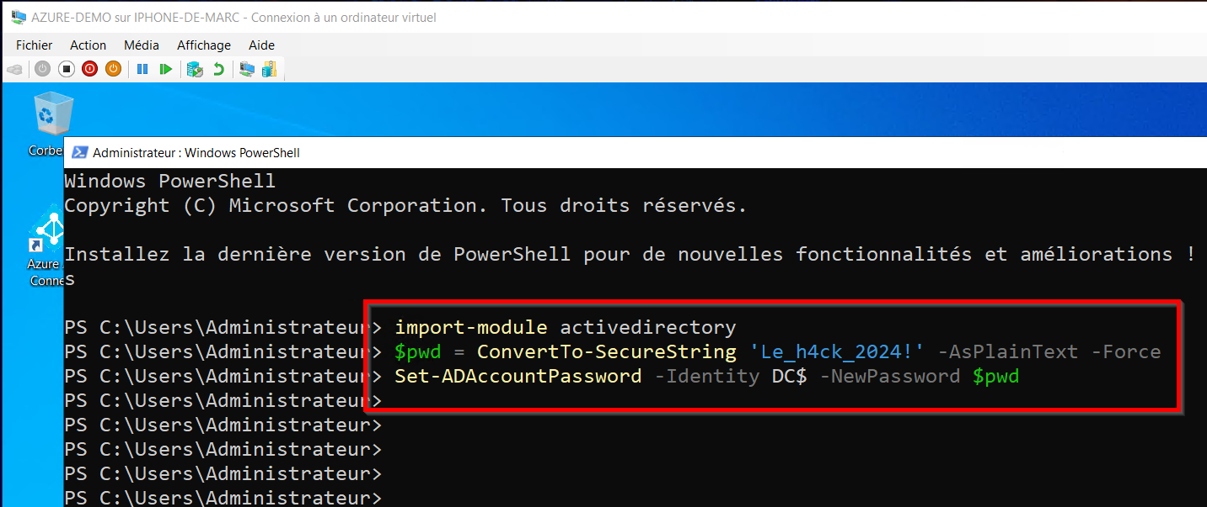
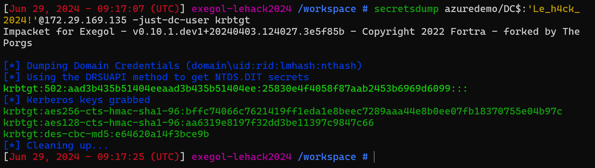
Or if you're not afraid to break everything...
If something goes wrong just use netdom to reset DC password and reboot :D

Slide 37

IF YOU HAVE ANY QUESTIONS ABOUT MY CATS, YOU CAN ASK.

